Slide 1

AASC Lesson 2.1:
Introduction to Search
Notes:
Find guidance inserted in the note section of each slide.

Slide 2

Terminal Learning Objectives
At the end of this lesson, the participant will be able to differentiate the levels of search and explain the capabilities and limitations of intermediate search

Slide 3
Overview
2.1.1 Introduction
2.1.2 Levels of Search
2.1.3 Different Types of Search
2.1.4 Search Team Structure and Roles
2.1.5 Search Equipment

Slide 4
2.1.1 Introduction

Slide 5
Definition of Search
The capability to locate specific targets using intelligence assessment, systematic procedures and appropriate detection techniques
Notes:
Military search capabilities are developed to locate and detect concealed threats . Although this training was developed based on military search activities, it is intended that this material is equally applicable to search activities undertaken by military, police or civilians that are employed in a PKOs with an IED threat.
Search is a capability that is an enabler to EOD/IEDD. All Arms Search Team (AAST), qualified to conduct Route Search or even Intermediate Search and Specialized Search Teams (SST) will often work in concert with an EOD/IEDD teams. The ability to locate and detect IEDs is crucial within any counter explosive threat capability. In order to defeat the device (DtD), a proactive rather than reactive approach is required to put pressure on the IED network. A key enabler in these efforts is locating and detecting IEDs and their components before they can achieve their desired effects.

Slide 6
What are we Searching For?
Improvised Explosive Devices (IEDs)
Component parts for IEDs
Homemade Explosives (HME)
Weapons and munitions
Terrorist/criminal funding/large amounts of money
Terrorist/criminal propaganda: leaflets, pamphlets
Notes:
What are we searching for?
Ask class to give an explanation of each bullet point.

Slide 7
Objectives of Search
Search is a key enabler, providing the means to shape and control the environment in which military assets are active or where there are security interests across the operational framework. Search can be broken down into two distinct elements: Pre-emptive Search and Protective Search.
Notes:
Search is a key enabler, providing the means to shape and control the environment in which military assets are active or where there are security interests across the operational framework. Search can be broken down into two distinct elements: Pre-emptive Search and Protective Search.

Slide 8
Objectives of Search
Pre-emptive Search
• Gain Intelligence
• Deny Resources and Opportunity
• Secure Material for Exploitation
Notes:
The objectives of pre-emptive search are to gather information and material for exploitation, to deprive a perpetrator of resources and to secure material for possible future evidential value. The detailed applications are following.
• Gain Intelligence. Information and material gathered during search operations is often a rich source of intelligence. Alongside Intelligence, Surveillance, and Reconnaissance (ISR) assets, this information allows for the creation of a full intelligence picture and informs of threats in theater, especially when it comes to the technical exploitation of explosive threats or hazards.
• Deny Resources and Opportunity. UN Commanders can gain or maintain the initiative in an operational environment through the reduction of a perpetrator’s capability to deliver explosive threats. Through the discovery and interdiction of weapons and explosives, it retains freedom of action for friendly forces, while reducing the extent to which a perpetrator can impose their will through attacks with conventional or IEDs.
• Secure Material for Exploitation . In order to identify perpetrator networks and their key capabilities and vulnerabilities, UN Forces must be able to collect, exploit and disseminate findings concerning adversarial technology and tactics. UN Forces engaged in operations must act and be seen to act in accordance with international and national legal frameworks in the collection of forensic evidence . Documentation, material handling and forensic awareness must adhere (where tactically viable) to identified best practices in order to assist any subsequent exploitation and possible prosecution. The following exploitation philosophy should be applied after assessment by those involved as best suits the situation. The exploitation philosophy involves three parts:
• Safety.
• Forensic integrity.
• Continuity of evidence.
The application this philosophy requires balancing these against each other in order to select the most suitable course of action with safety considerations inevitably carrying more weight than others. The prioritization of the three parts of the exploitation philosophy depends on the key operational actions defined by the commander. In every case, safety is always the priority in all exploitation activities.

Slide 9
Objectives of Search
Protective Search
• Force Protection
• Protection of Pre-Planned Events
• Protection of Critical Infrastructure
Notes:
The objective of protective search is to protect potential search targets as well as to protect UN/Unit assets. This is achieved through the following:
• Force Protection. Protective measures taken to mitigate hostile actions against friendly personnel, resources, facilities, and critical information. Search should be considered a key element of UN FP. Protective search provides means of reducing risk to UN Personnel and enables freedom of action/movement.
• Protection of Pre-Planned Events. Protective search provide advanced security to protect potential targets during pre-planned events, according to the level of threat and the estimated consequence of failure. By executing a pre-emptive search, UN Forces can mitigate explosive threats in the target area, route or building.
• Protection of Critical Infrastructure. Search can be utilized to protect critical military, governmental, industrial, and civil infrastructure within the theater of operation, providing vital protection to the economy and well-being of the host nation.

Slide 10
Principles of Search
Systematic
Flexible
Focused
Safe
Notes:
Success of search as a capability is largely due to the procedures founded on four basic principles that can be adapted to suit the operational tempo and tactical situation. The procedures and techniques involved in all search activities should be principle based, regardless of the exact details of the actions to be taken. The level of assurance provided varies on the level of training and equipment available. The search principles are:
• Systematic. All search activities regardless of the level they are conducted at are systematic in their nature which is achieved by the approach being careful, deliberate, detailed and methodical. The systematic search principle applies equally to the planning, co-ordination, and execution of all search operations.
• Flexible. TTP as well as equipment must be adapted to an evolving operational/tactical environment where the perpetrator constantly changes his methods of operation in an attempt to either trap, deceive, mislead or misdirect search capabilities. All procedures should be flexible but consistent in their application without compromising safety.
• Focused. All planned search operations should be targeted and have clearly defined objectives that contribute to the mission. The political, cultural, social, and economic impact of any intended search operation should be addressed when considering the objectives.
• Safe. Search activities are conducted within the margin of acceptable level of risk for the operation and the assessment associated with it as determined by the commander.

Slide 11
Search Effects
Shape
Deter
Deny
Protect
Exploit
Notes:
Search can support and deliver effects to reinforce a UN Commander’s intent in protective and pre-emptive operations from the tactical to the strategic level. This is supported through the following effects:
Shape the conditions for future operations.
Deter adversaries.
Deny resources and freedom of action for the perpetrators.
Protect UN or supported forces and secure freedom of action and movement; and
Exploit technical and tactical intelligence gained through search operations.

Slide 12
2.1.2 Levels of Search

Slide 13
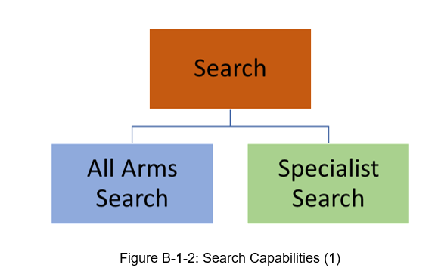
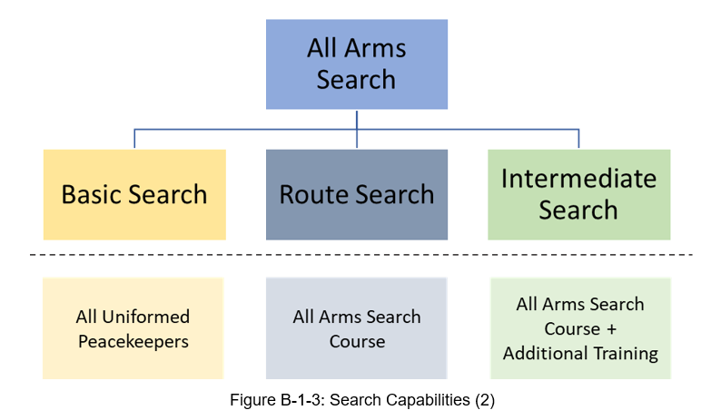
Levels of Search
Advanced
Basic
Intermediate
Notes:
In its broadest terms search can be broken down into all arms search capabilities and specialist search capabilities.
• All Arms Search. Search capabilities employed by non-specialist members of a unit. There are different levels of all arms search capabilities.
• Specialist Search. Search capabilities employed by advanced search personnel trained, equipped, and qualified to do so. Information regarding Specialist Search is contained in the UN Military Engineer Unit Manual.
Within All Arms Search there are three levels of search capability, namely:
Basic Search – This is a skill all peacekeeper should have which gives them an awareness of search and basic search TTPs.
Route Search – Route search is a team skill for conducting assessed parts of routes for the presence of EO and IEDs.
Intermediate Search – Intermediate search includes route search skills with the addition skills such as Area Search, and compound searches.
In simpler terms, we can say that Search is conducted at three levels: basic, intermediate and advanced. [build Slide]

Slide 14
Levels of Search
Search Type | Basic | Route | Intermediate | Advanced/Specialist (not a UN PKO reqt)
Search Aware (5/25m)
Person
Vehicle
VP Check (low threat)
Building
Route
Area
Defensive Building Search or VIP protective search
Aircraft, Train, Maritime vessel
Confined spaces
Hazardous Environments
Etc…
 | Permitted
 | Possibly all arms or specialized determined by HEAT factors and/or training level
 | Not Permitted

Slide 15
Levels of Search
 | Permitted
 | Possibly all arms or specialized determined by HEAT factors and/or training level
 | Not Permitted
H azardous nature of the operating environment.
E quipment requirements are specialized.
A ssurance level required is high.
T hreat level is high.
Notes:
Certain types of searches such as route, area and building searches can be either an all arms task or a specialized task. In each case, defined training and possibly equipment support is required for these capabilities to be employed by all arms. The criteria that are used to determine if these search activities are an All Arms task or a specialized task is determined by an assessment of the following factors and based on the mission level treat assessment.
H azardous nature of the operating environment. Is the environment permissive and restrictive. i.e. extreme heat or cold, confined spaces, working at heights etc?
E quipment requirements are specialized. Can the search be conducted without equipment or does it need specialist equipment that requires additional training?
A ssurance level required is high. How detailed does the search need to be? Do we need to just check for obvious signed of IED components or do we need to be 100% sure that there is no threat. The higher the assurance required the higher the level of search required.
T hreat level is high. Is there a known or specific IED threat? Are search teams being specifically targeted? Basic Search may only be carried uot where there is no specific threat or no intelligence of the searcher being targeted.

Slide 16
2.1.3 Types of Search

Slide 17
Levels of Search
Search Type | Basic | Route | Intermediate | Advanced/Specialist (not a UN PKO reqt)
Search Aware (5/25m)
Person
Vehicle
VP Check (low threat)
Building
Route
Area
Defensive Building Search or VIP protective search
Aircraft, Train, Maritime vessel
Confined spaces
Hazardous Environments
Etc…
 | Permitted
 | Possibly all arms or specialized determined by HEAT factors and/or training level
 | Not Permitted

Slide 18
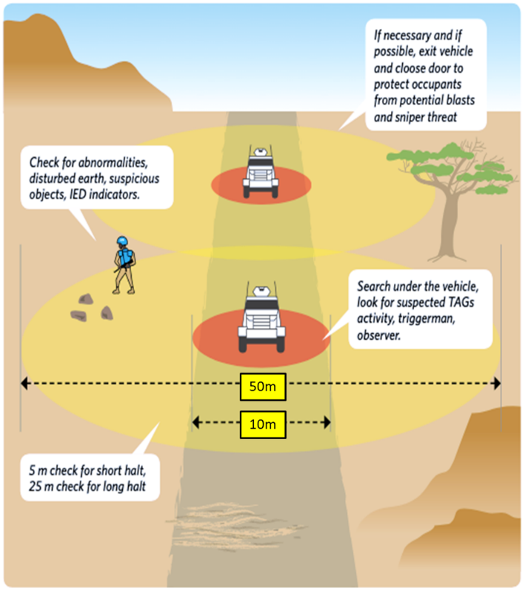
Levels of Search
Search Type | Basic
Search Aware (5/25m)
Person
Vehicle
VP Check (low threat)
Building
Route
Area
Defensive Building Search or VIP protective search
Aircraft, Train, Maritime vessel
Confined spaces
Hazardous Environments
Etc…
 | Permitted
 | Possibly all arms or specialized determined by HEAT factors and/or training level
 | Not Permitted
Notes:
Basic Search is a capability which is required by every Peacekeeper and should be part of the basic military training.
Basic Search. The lowest level of search capability. It provides all personnel with a fundamental understanding of the prevalent threat and those measures they, as individuals can adopt in order to optimize FP. Basic search training normally covers search awareness but may also include other procedures. Basic search teams are normally ad hoc. Basic search capabilities may or may not involve the use of search equipment and covers the following capabilities:
•Search awareness. Search awareness is the most basic skill level and is utilized for FP. A Search aware person is normally trained to conduct searches of a person or vehicle or conduct a basic threat assessment (subject to a periodic threat update), 5m and 25m checks and workplace checks.

Slide 19

Levels of Search
Search Type | Basic
Search Aware (5/25m)
Person
Vehicle
VP Check (low threat)
Building
Route
Area
Defensive Building Search or VIP protective search
Aircraft, Train, Maritime vessel
Confined spaces
Hazardous Environments
Etc…
 | Permitted
 | Possibly all arms or specialized determined by HEAT factors and/or training level
 | Not Permitted
Notes:
Basic Search. The lowest level of search capability. It provides all personnel with a fundamental understanding of the prevalent threat and those measures they, as individuals can adopt in order to optimize FP. Basic search training normally covers search awareness but may also include other procedures. Basic search teams are normally ad hoc. Basic search capabilities may or may not involve the use of search equipment and covers the following capabilities:
•Search awareness. Search awareness is the most basic skill level and is utilized for FP. A Search aware person is normally trained to conduct searches of a person or vehicle or conduct a basic threat assessment (subject to a periodic threat update), 5m and 25m checks and workplace checks.
•Person search. Search of a person to detect components, weapons, ammunition, or any other exploitable intelligence that a person may attempt to conceal.

Slide 20
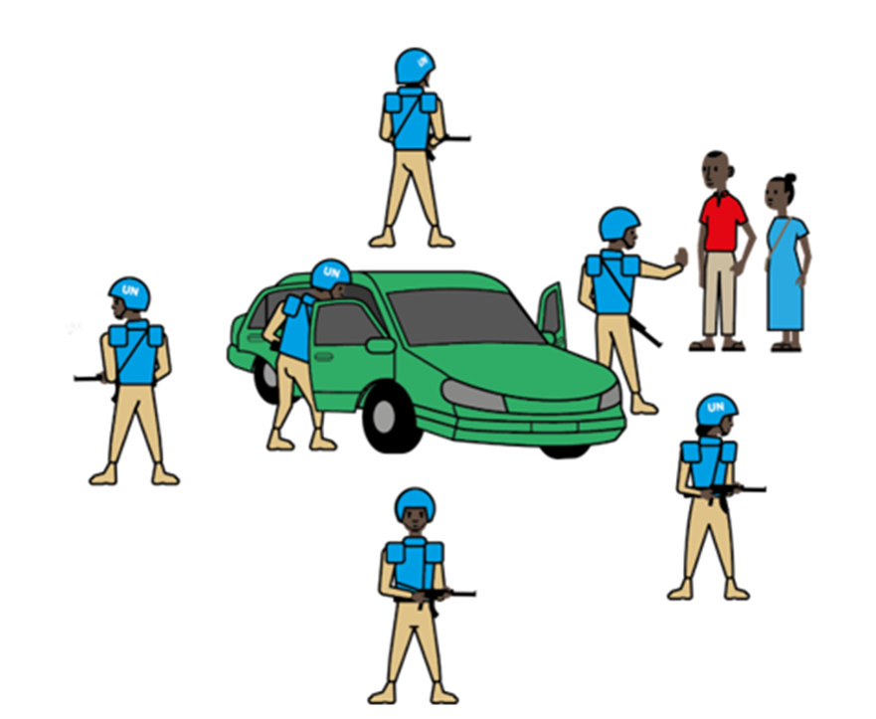
Levels of Search
Search Type | Basic
Search Aware (5/25m)
Person
Vehicle
VP Check (low threat)
Building
Route
Area
Defensive Building Search or VIP protective search
Aircraft, Train, Maritime vessel
Confined spaces
Hazardous Environments
Etc…
 | Permitted
 | Possibly all arms or specialized determined by HEAT factors and/or training level
 | Not Permitted
Notes:
Basic Search. The lowest level of search capability. It provides all personnel with a fundamental understanding of the prevalent threat and those measures they, as individuals can adopt in order to optimize FP. Basic search training normally covers search awareness but may also include other procedures. Basic search teams are normally ad hoc. Basic search capabilities may or may not involve the use of search equipment and covers the following capabilities:
•Search awareness. Search awareness is the most basic skill level and is utilized for FP. A Search aware person is normally trained to conduct searches of a person or vehicle or conduct a basic threat assessment (subject to a periodic threat update), 5m and 25m checks and workplace checks.
•Person search. Search of a person to detect components, weapons, ammunition, or any other exploitable intelligence that a person may attempt to conceal.
•Vehicle search. The search of a vehicle to detect vehicle-borne improvised explosive devices (VBIEDs), IED components, weapons, ammunition, or any other object that a perpetrator has attempted to conceal. A vehicle search involves an initial check of persons and their vehicle, from which an assessment can be made as to whether any further search is required. Vehicle search within basic search involves initial checks and can involve primary searches.

Slide 21

Levels of Search
Search Type | Basic
Search Aware (5/25m)
Person
Vehicle
VP Check (low threat)
Building
Route
Area
Defensive Building Search or VIP protective search
Aircraft, Train, Maritime vessel
Confined spaces
Hazardous Environments
Etc…
 | Permitted
 | Possibly all arms or specialized determined by HEAT factors and/or training level
 | Not Permitted
Notes:
Basic Search. The lowest level of search capability. It provides all personnel with a fundamental understanding of the prevalent threat and those measures they, as individuals can adopt in order to optimize FP. Basic search training normally covers search awareness but may also include other procedures. Basic search teams are normally ad hoc. Basic search capabilities may or may not involve the use of search equipment and covers the following capabilities:
•Search awareness. Search awareness is the most basic skill level and is utilized for FP. A Search aware person is normally trained to conduct searches of a person or vehicle or conduct a basic threat assessment (subject to a periodic threat update), 5m and 25m checks and workplace checks.
•Vehicle search. The search of a vehicle to detect vehicle-borne improvised explosive devices (VBIEDs), IED components, weapons, ammunition, or any other object that a perpetrator has attempted to conceal. A vehicle search involves an initial check of persons and their vehicle, from which an assessment can be made as to whether any further search is required. Vehicle search within basic search involves initial checks and can involve primary searches.
•Person search. Search of a person to detect components, weapons, ammunition, or any other exploitable intelligence that a person may attempt to conceal.
VP Check or VP 360 or VP drill. This is a drill conducted when Vulnerable Points on a route cannot be avoided and where there is low or no specific IED threat. The drill can be conducted with or without specialist equipment. This drill is taught on the EHAT course. Note the HEAT factor. If there is a known or high threat, this may not be conducted by Basic Search.

Slide 22
Levels of Search
Search Type | Basic
Search Aware (5/25m)
Person
Vehicle
VP Check (low threat)
Building
Route
Area
Defensive Building Search or VIP protective search
Aircraft, Train, Maritime vessel
Confined spaces
Hazardous Environments
Etc…
H – permissive operating environment
E – No specialist equipment required
A – Low level of assurance is acceptable
T – IED threat level is low
 | Permitted
 | Possibly all arms or specialized determined by HEAT factors and/or training level
 | Not Permitted
Notes:
Heat Factors to permit VP Check.
H – permissive operating environment. If it is a non-permissive environment for peacekeepers including from direct attacks or severe environmental conditions, this should not be carried out.
E – No specialist equipment required. This drill does not require specialist equipment. If the threat determines equipment is required, this drill may not be carried out.
A – Low level of assurance is acceptable. This drill does not require equipment and so the assurance level is low. Where high assurance that there is no threat remaining after the search, this task should be carried out be intermediate search.
T – IED threat level is low. This drill should only be carried out where there is a low IED threat. Where there is credible intelligence to suggest an IED at a vulnerable point, a route search should be conducted.

Slide 23
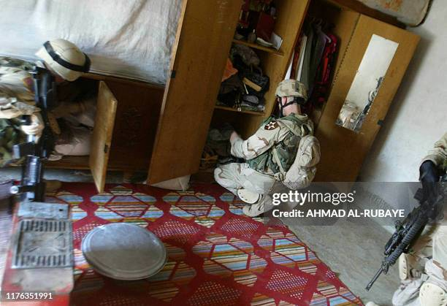
Levels of Search
Search Type | Basic
Search Aware (5/25m)
Person
Vehicle
VP Check (low threat)
Building
Route
Area
Defensive Building Search or VIP protective search
Aircraft, Train, Maritime vessel
Confined spaces
Hazardous Environments
Etc…
 | Permitted
 | Possibly all arms or specialized determined by HEAT factors and/or training level
 | Not Permitted
Notes:
Basic Search. The lowest level of search capability. It provides all personnel with a fundamental understanding of the prevalent threat and those measures they, as individuals can adopt in order to optimize FP. Basic search training normally covers search awareness but may also include other procedures. Basic search teams are normally ad hoc. Basic search capabilities may or may not involve the use of search equipment and covers the following capabilities:
•Search awareness. Search awareness is the most basic skill level and is utilized for FP. A Search aware person is normally trained to conduct searches of a person or vehicle or conduct a basic threat assessment (subject to a periodic threat update), 5m and 25m checks and workplace checks.
•Vehicle search. The search of a vehicle to detect vehicle-borne improvised explosive devices (VBIEDs), IED components, weapons, ammunition, or any other object that a perpetrator has attempted to conceal. A vehicle search involves an initial check of persons and their vehicle, from which an assessment can be made as to whether any further search is required. Vehicle search within basic search involves initial checks and can involve primary searches.
•Person search. Search of a person to detect components, weapons, ammunition, or any other exploitable intelligence that a person may attempt to conceal.
VP Check or VP 360 or VP drill. This is a drill conducted when Vulnerable Points on a route cannot be avoided and where there is low or no specific IED threat. The drill can be conducted with or without specialist equipment. This drill is taught on the EHAT course. Note the HEAT factor. If there is a known or high threat, this may not be conducted by Basic Search.
•Property search. A physical and visual search of areas and property where the concealment of prohibited items is possible. This can include but is not limited to, the search of baggage, buildings, and urban areas/street furniture without the use of specialist equipment in a low threat environment. The Search of Buildings may be permitted in some operations but it will be subject to Rule of Engagement and local laws. Generally this is a task carried out by police, not military peacekeepers. Building search will also be subject to threat. Note the HEAT factor. If there is a threat, this may not be conducted by basic search.
Image details: gettyimages.com Creator: AHMAD AL-RUBAYE, Credit: AFP via Getty Images, Copyright: 2004 AFP

Slide 24
Levels of Search
Search Type | Basic
Search Aware (5/25m)
Person
Vehicle
VP Check (low threat)
Building
Route
Area
Defensive Building Search or VIP protective search
Aircraft, Train, Maritime vessel
Confined spaces
Hazardous Environments
Etc…
H – permissive operating environment
E – No specialist equipment required
A – Low level of assurance is acceptable
T – IED threat level is low
 | Permitted
 | Possibly all arms or specialized determined by HEAT factors and/or training level
 | Not Permitted
Notes:
Heat Factors to permit VP Check.
H – permissive operating environment. Where there is a hostile environment, this task must be left to intermediate or advanced search.
E – No specialist equipment required. If, due to the threat, specialist equipment is needed, then this task should be left to intermediate or advanced search.
A – Low level of assurance is acceptable. Basic search can only offer low level of assurance. Where higher level of assurance is required, this should be conducted be intermediate or advanced search teams.
T – IED threat level is low. This task may only be carried out where there is a low or no IED threat. Basic search may never search un-occupied buildings.

Slide 25
Levels of Search
Search Type | Basic | Route | Intermediate | Advanced/Specialist (not a UN PKO reqt)
Search Aware (5/25m)
Person
Vehicle
VP Check (low threat)
Building
Route
Area
Defensive Building Search or VIP protective search
Aircraft, Train, Maritime vessel
Confined spaces
Hazardous Environments
Etc…
 | Permitted
 | Possibly all arms or specialized determined by HEAT factors and/or training level
 | Not Permitted

Slide 26

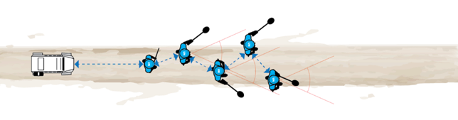
Levels of Search
Search Type | Route
Search Aware (5/25m)
Person
Vehicle
VP Check (low threat)
Building
Route
Area
Defensive Building Search or VIP protective search
Aircraft, Train, Maritime vessel
Confined spaces
Hazardous Environments
Etc…
 | Permitted
 | Possibly all arms or specialized determined by HEAT factors and/or training level
 | Not Permitted
Notes:
Route Search. A unit level search capability used in the search of assessed portions of a route for the presence of EO and in line with for the threat for which the teams have been trained. It may involve the knowledge and skills to be able to assess a VP or VA and determine how best it should be searched in order to isolate areas and locate IEDs so they can be rendered safe by IEDD or other suitably qualified personnel or alternatively confirm the absence of IEDs at a given VP or VA. Route search can be a UN mission specific or stand-alone capability depending on mission requirements. Route search can be used on roads, tracks, railway lines, and along any mounted or dismounted direction of travel. Route search of railway lines can be a route search team task but may require an advanced search team depending on the threat assessment and HEAT factors.
Military Personnel having completed the All Arms Search Team (AAST) are capable to conduct Route Search.
Sometimes referred to as Patrol Search.

Slide 27
Levels of Search
Search Type | Basic | Route | Intermediate | Advanced/Specialist (not a UN PKO reqt)
Search Aware (5/25m)
Person
Vehicle
VP Check (low threat)
Building
Route
Area
Defensive Building Search or VIP protective search
Aircraft, Train, Maritime vessel
Confined spaces
Hazardous Environments
Etc…
 | Permitted
 | Possibly all arms or specialized determined by HEAT factors and/or training level
 | Not Permitted
Notes:
Intermediate Search. Undertake all basic and route search tasks in line with HEAT factors with key additional capabilities of intermediate search being area search and building search. An increased level of training and specialist equipment is required at this level of capability compared to route search and basic search.

Slide 28
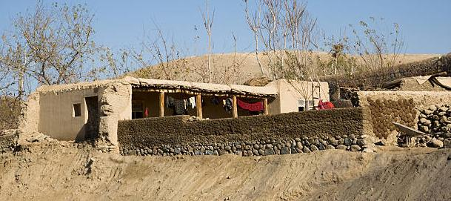
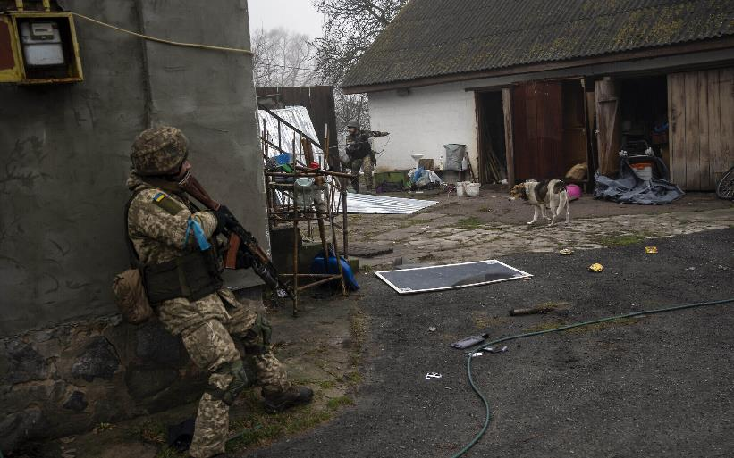
Levels of Search
Search Type | Intermediate
Search Aware (5/25m)
Person
Vehicle
VP Check (low threat)
Building
Route
Area
Defensive Building Search or VIP protective search
Aircraft, Train, Maritime vessel
Confined spaces
Hazardous Environments
Etc…
 | Permitted
 | Possibly all arms or specialized determined by HEAT factors and/or training level
 | Not Permitted
Notes:
A building search refers to the systematic search of a structure or facility to locate threat items therein. Area searches and building searches are typically undertaken as part of planned operations in conjunction with a security element that first secures a cordon around a given target area or location prior to a search element systematically searching for explosive threats and or weapons and/or components thereof.
NOTE: building searches may be an intermediate or advanced search capability. Typically, part of an intelligence led operation the distinction between such operations being an intermediate or advanced search requirement is determined by an assessment which is elaborated. At the intermediate level, building search is generally a force protection measure. For example a search of a structure that is to be occupied as a HQ or overnight location.
Intermediate Search can be conducted be Military Personnel having completed the All Arms Search Training and received additional training.
Where there is a high threat based on a threat assessment, this task may not be carried out by intermediate search and must only be carried out by specialist search teams or IEDD operator search.
Image Top – Example of a domestic compound in Afghanistan. Creator: MivPiv, Credit: Getty Images/iStockphoto, Copyright: Mie Ahmt
Image Bottom - Ukrainian soldiers operate inside an abandoned house during a military sweep to search for possible remnants of Russian troops after their withdrawal from villages in the outskirts of Kyiv, Ukraine, April 1, 2022. (AP Photo/Rodrigo Abd)

Slide 29
Levels of Search
Search Type | Intermediate
Search Aware (5/25m)
Person
Vehicle
VP Check (low threat)
Building
Route
Area
Defensive Building Search or VIP protective search
Aircraft, Train, Maritime vessel
Confined spaces
Hazardous Environments
Etc…
H – May be non-permissive environment
E – Specialist equipment is required
A – Moderate level of assurance is required
T – IED threat may exist, but no intelligence to suggest specific threat in the building to be searched
 | Permitted
 | Possibly all arms or specialized determined by HEAT factors and/or training level
 | Not Permitted
Notes:
H – For intermediate search teams, the operating environment may be non-permissive environment. E.g. Mali or Somalia where peacekeepers are targeted by belligerents .
E – Specialist equipment is required and therefore only intermediate search teams of above may conduct this type of search.
A – Moderate level of assurance is required. Due to a possible IED or UXO threat, a higher level of assurance is required.
T – IED threat may exist, but no intelligence to suggest specific threat in the building to be searched. If there has been recent trends in placing IED in building or the targeting or search teams, or there is intelligence to suggest presence of an IED, this task should be carried out by advanced or specialist Search teams.

Slide 30
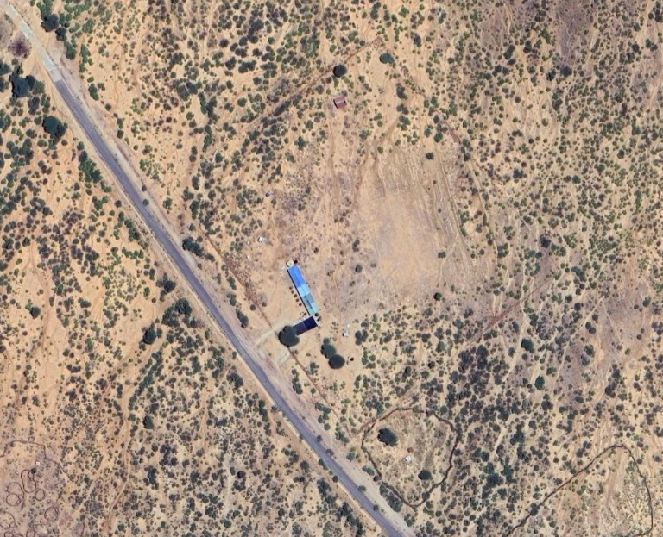
Levels of Search
Search Type | Intermediate
Search Aware (5/25m)
Person
Vehicle
VP Check (low threat)
Building
Route
Area
Defensive Building Search or VIP protective search
Aircraft, Train, Maritime vessel
Confined spaces
Hazardous Environments
Etc…
 | Permitted
 | Possibly all arms or specialized determined by HEAT factors and/or training level
 | Not Permitted
Notes:
Area search involves the systematic search of a target area with the aim of locating items that have been, lost, misplaced, discarded, or hidden. Alternatively area search may be carried out as a force protection measure prior to the occupation of a new location e.g. building a new tactical operating base or an overnight location for a vehicle convoy.
Area search can occur in rural environments or open areas in an urban environment. An area search can either locate illegal resources or provide assurance that the area contains no specified targets or resources. A building search refers to the systematic search of a structure or facility to locate threat items therein. Area searches and building searches are typically undertaken as part of planned operations in conjunction with a security element that first secures a cordon around a given target area or location prior to a search element systematically searching for explosive threats, weapons and/or components thereof.
NOTE: Area search or building searches may be an intermediate or advanced search capability. Typically, part of an intelligence led operation the distinction between such operations being an intermediate or advanced search requirement is determined by an assessment which is elaborated.
Intermediate Search can be conducted be Military Personnel having completed the All Arms Search Training and received additional training.
Where there is a high threat based on a threat assessment, this task may not be carried out by intermediate search and must only be carried out by specialist search teams or IEDD operator search.

Slide 31
Levels of Search
Search Type | Intermediate
Search Aware (5/25m)
Person
Vehicle
VP Check (low threat)
Building
Route
Area
Defensive Building Search or VIP protective search
Aircraft, Train, Maritime vessel
Confined spaces
Hazardous Environments
Etc…
H – May be non-permissive environment
E – Specialist equipment is required
A – Moderate level of assurance is required
T – IED threat may exist, but no intelligence to suggest specific threat targeting searchers
 | Permitted
 | Possibly all arms or specialized determined by HEAT factors and/or training level
 | Not Permitted
Notes:
H – May be non-permissive environment.
E – Specialist equipment is required
A – Moderate level of assurance is required
T – IED threat may exist, but no intelligence to suggest specific threat targeting searchers

Slide 32
Levels of Search
Search Type | Basic | Route | Intermediate | Advanced/Specialist (not a UN PKO reqt)
Search Aware (5/25m)
Person
Vehicle
VP Check (low threat)
Building
Route
Area
Defensive Building Search or VIP protective search
Aircraft, Train, Maritime vessel
Confined spaces
Hazardous Environments
Etc…
 | Permitted
 | Possibly all arms or specialized determined by HEAT factors and/or training level
 | Not Permitted

Slide 33
Levels of Search
Search Type | Advanced/Specialist (not a UN PKO reqt)
Search Aware (5/25m)
Person
Vehicle
VP Check (low threat)
Building
Route
Area
Defensive Building Search or VIP protective search
Aircraft, Train, Maritime vessel
Confined spaces
Hazardous Environments
Etc…
Carried out by specialist.
Not usually a requirement of UN PKO
Outside the scope of this course
 | Permitted
 | Possibly all arms or specialized determined by HEAT factors and/or training level
 | Not Permitted

Slide 34
2.1.4 Search Team Structure

Slide 35
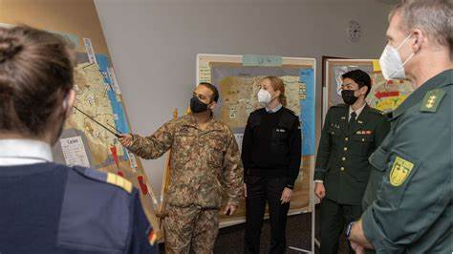
Search Team Structure
Search Advisor
Notes:
Search Advisors are Specialist staff at all levels of command, who provide advice and assist in planning of search related activities. The Search Advisor must be current on all policy and doctrine to ensure that the correct advice can be provided to the FC, Sector or unit commander they report to and their respective staffs on all search related matters, at all staff levels. Where possible the Search Advisor role should be dedicated within a UN Mission.​
Under certain circumstances, the role can be double-headed, performing the tasks of the IED TM Advisor and the Search Advisor. Alternatively, a Search Advisor may be a role that a suitable qualified person is given. A Search Advisor must be qualified for Specialist search and have appropriate experience in providing search advice on staff level. ​
​
Some of the Search Advisors Tasks include:​
A Search Advisor is responsible for:​
• Advice to Force Engineers or unit commanders, on search capacity and deployment, depending on the level they are operating at. ​
• Prioritizing and coordinating search matters with supporting Host Nation and non-governmental organizations (NGOs), where appropriate.​
• Synchronizing and aligning available Search capabilities and responses across the AO.​
• Supporting the intelligence and exploitation cycle through search specific threat assessments and the identification of adversary TTPs.​
• Determining which search assets are most appropriate for a task by understanding the capabilities, responsibilities, and support requirements of search assets.​
• Conducting an estimate and planning for search, based on threats, perpetrator intent and capability, before preparing orders for a search commander and/or search teams.​
• Providing support and advice to the search team commander conducting search activities

Slide 36

Search Team Structure
Intermediate or Route Search Team
Operate as a team.
  Team Commander
  2IC
  Minimum 4 Searchers
Notes:
In the UN mission setting the success of the IED TM effort is largely dependent on information-based operations against IEDs and precursors. All mobility units are to count with All Arms Search Teams (AAST) comprised of trained searchers, equipped with precision search equipment and ECM, capable to conduct basic search procedures.
Each member of a search team must be suitably trained and equipped for the role and search capability they are to provide during the search activities for that mission. As a minimum, a search team should be composed of the following members.
Image Right – Bangladeshi Search Team on operations in Mali.

Slide 37
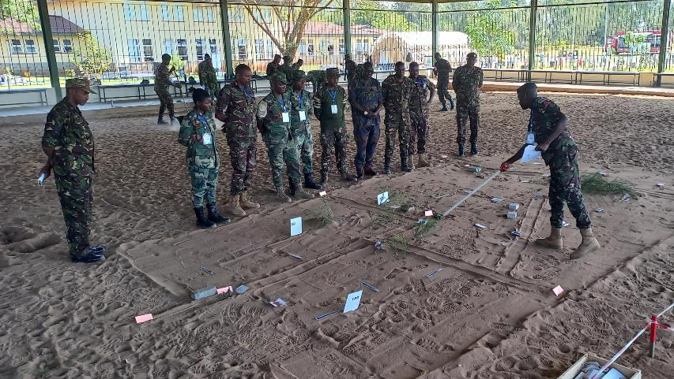
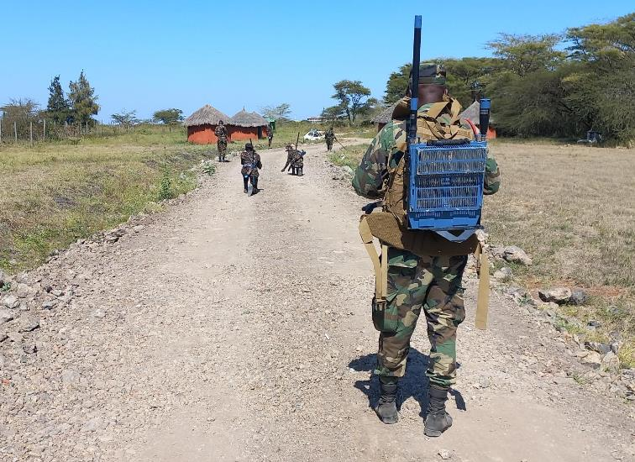
Search Team Structure
Intermediate or Route Search Team
  Team Commander
    Usually Corporal to Sergent
    Commands the Search Team
    Conducts Search of specific locations under the guidance of the Search Advisor or IED Threat Mitigation Advisor
Notes:
Search Team Commander. The Search Team Commander runs the team, co-ordinates with other agencies, and works in close coordination with the Search Advisor. He/She commands the team in order to achieve the task given by the Search Advisor.
Team Commander
Usually Corporal to Sergent
Commands the Search Team
Conducts Search of specific locations under the guidance of the Search Advisor or IED Threat Mitigation Advisor
Image Top – Team Commander Briefs his team prior to the start of a route search. Image Courtesy Jordan Sorabjee
Image Bottom – Team Commander commanding and controlling his team during a route search. Image Courtesy Jordan Sorabjee

Slide 38

Search Team Structure
Intermediate or Route Search Team
  Scribe or 2IC
    Usually Lance Corporal to Corporal
    Assists the Team Commander
    Responsible for equipment and sustaining the search team
    Responsible for maintaining any search documentation
Notes:
Search Team Scribe. The second in command of the Search Team. Responsible for providing assistance to the Search Team commander and for completing the necessary documentation this includes notes on what the Search Team is looking for, any items or evidence found and for ensuring all legal documents are in the possession of the team or are completed for judicial evidence in the future.

Slide 39
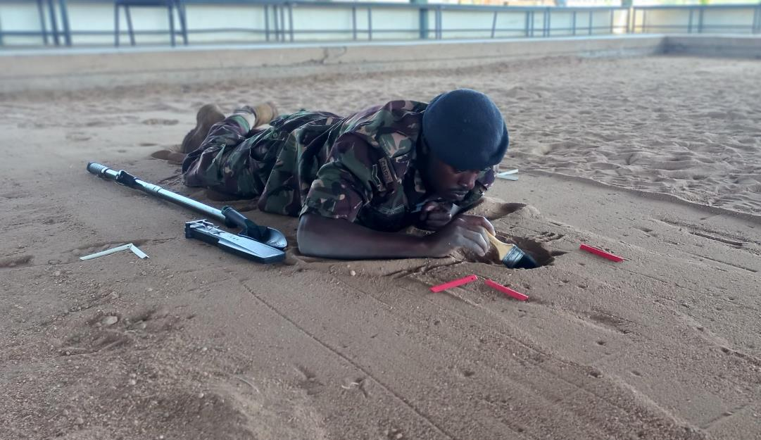
Search Team Structure
Intermediate or Route Search Team
  Searchers or search pair
    Usually private
    Operate as a pair
    Carry out a search using appropriate equipment and techniques under the command of the Search Team Commander
    Usually 2 pairs per team, but may be 3 pairs depending on threat
Notes:
Searchers shall be deployed in pairs with a minimum of two Search Pairs for safe, effective, and efficient operation. Search Pairs work under the direction of the Search Team Commander. They must have received the intent, threat, and desired effect in the Search Advisor’s orders.
Image – Searcher carrying out a confirmation drill. Image Courtesy Jordan Sorabjee

Slide 40
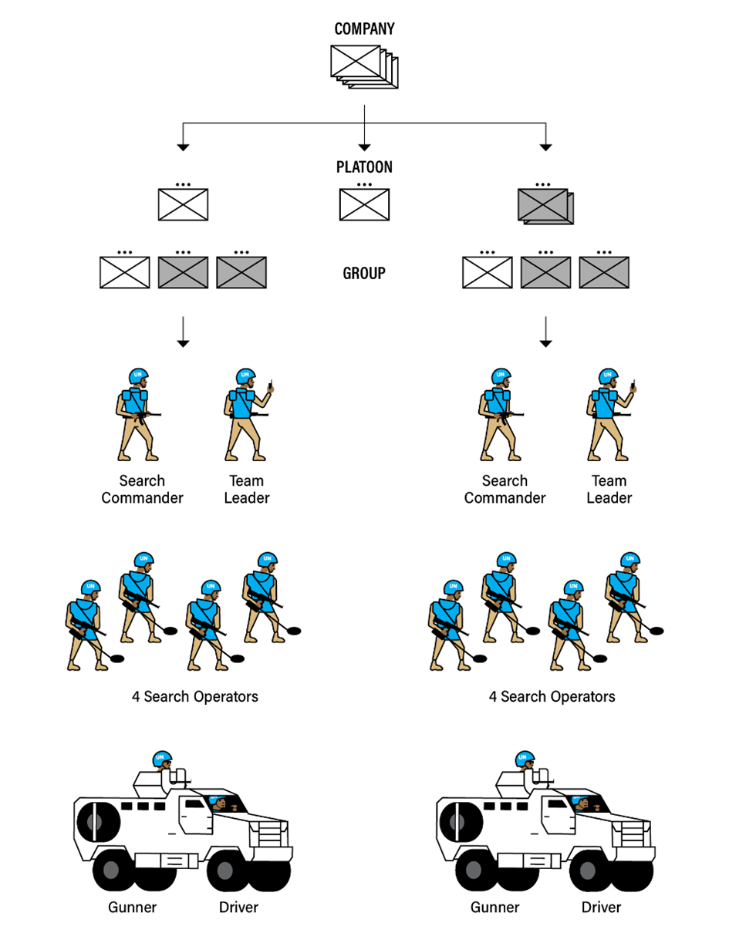
Search Team Structure
Notes:
For UN operations, generally there is 1 search team per Company. This is of course subject to the specific mission and threat. This is in order to allow each mobility company to operate independently in an IED environment. Its also worth nothing that generally a search team needs to be supported with a vehicle (with blast protection) a gunner and a driver.

Slide 41
2.1.5 Search Equipment

Slide 42
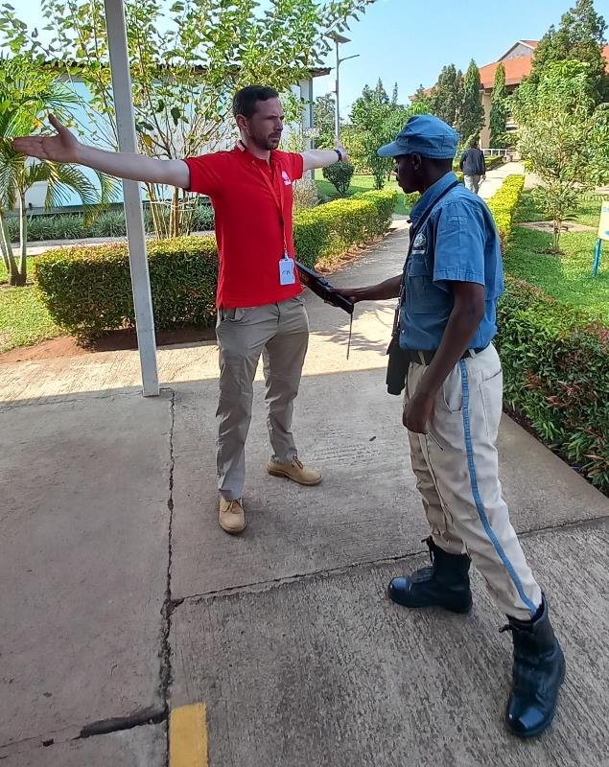
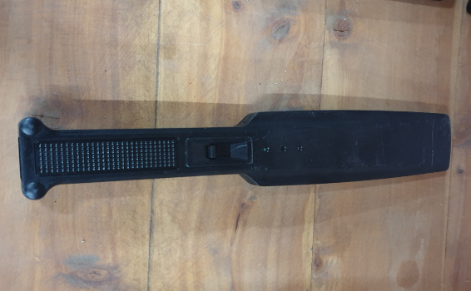

Search Equipment
Hand Held Detector (wand)
Notes:
Hand held metal detectors are designed for quick and efficient body search scanning for knives, weapons and concealed metal objects. These detectors require very limited training and are very effective. These may also be used to complement other detectors when trying to locate an IED/EO or components (see image Bottom)
All images courtesy Jordan Sorabjee.

Slide 43
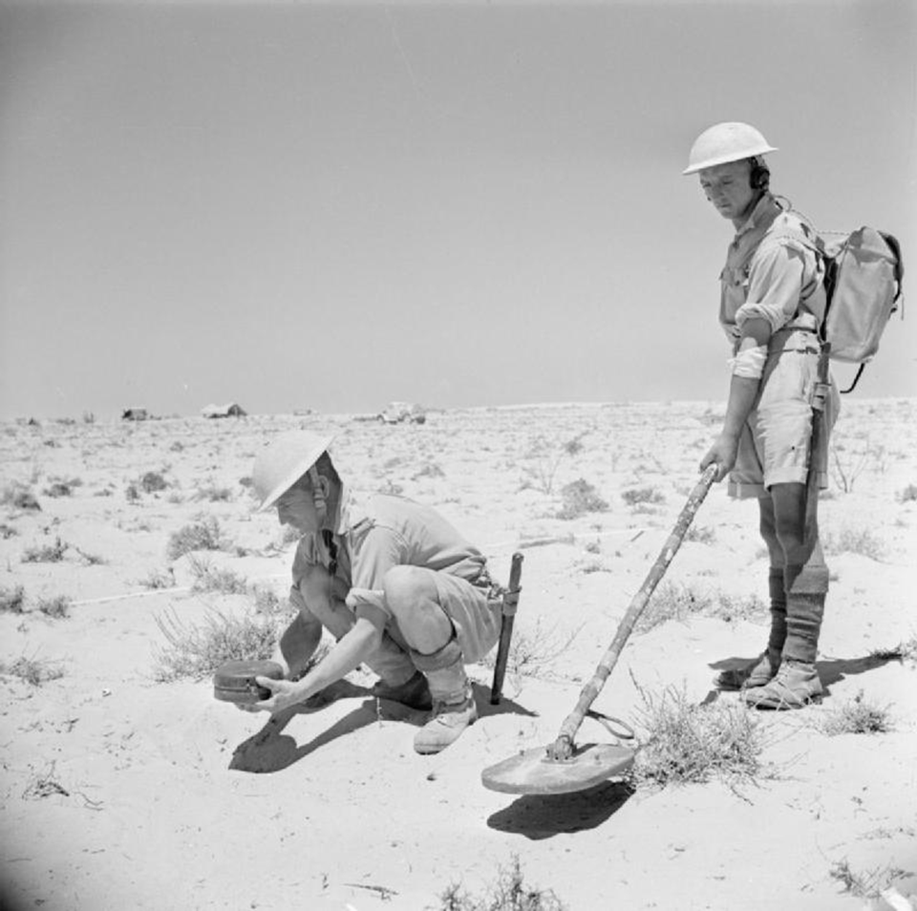
Search Equipment
Detectors
  Used to systematically search for concealed devices
  Categorized as:
    Active
    Passive
    Dual Use
Notes:
Notes required

Slide 44
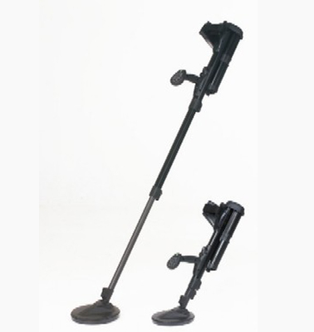
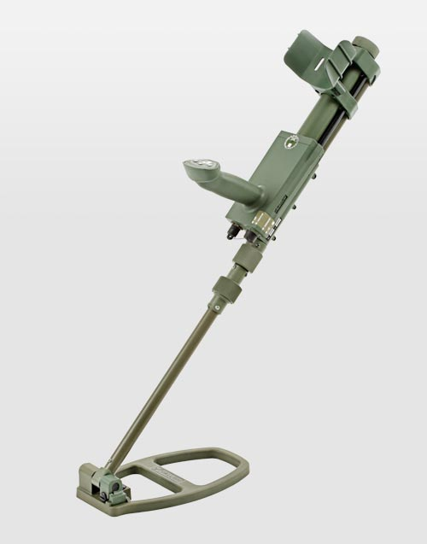
Search Equipment
Detectors (Active)
  Detectors for larger objects containing metals such as mines and UXO
  IED parts such as pressure plates with a high metal content.
  For AAST in IED threat environments with high-metal content explosive devices
  Usually very cheap
Important Note – These Types of devices must not be used where there is a risk that an active detector may initiate a device, UXO or Mine.
Notes:
Detectors for larger objects containing metals such as mines and UXO, but also IED parts such as pressure plates with a high metal content.
For AAST in IED threat environments with high-metal content explosive devices. These devices are called active because they emit an electromagnetic signal that is effected metallic objects.
The two images are examples of commonly found active metal detectors:
Image Top – Minelab F3
Image Bottom – Vallon VMH3

Slide 45
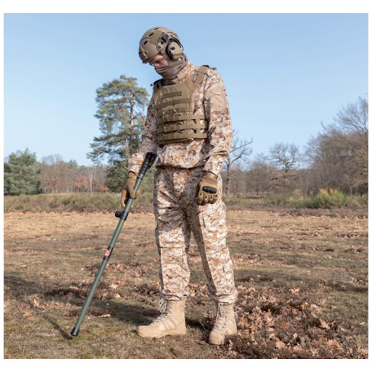
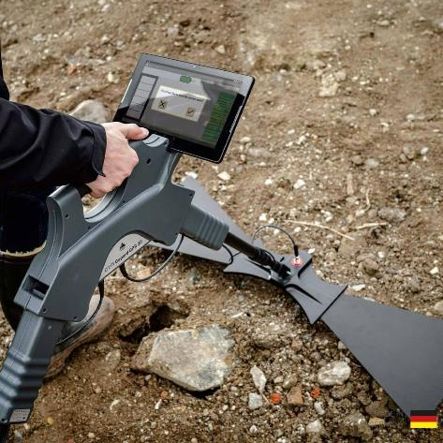
Search Equipment
Detectors (Dual Use)
  Employ technology that does not interfere with electronic components
  Generally are either:
    Magnetometers
    Ground Penetrating Radar (GPR)
  Often expensive and require more training
Notes:
Passive metal detectors employ technology that does not interfere with the device. Generally these tend employ one of two techniologies:
Magnetometers - Detector specifically designed to detect large (buried) objects with a high ferrous content. Mainly used to find UXO but may also be used where there are High metal Content IEDs which are affected by active detectors.
Ground Penetrating Radar -
Image Top – Magnetometer style detector. SC-100 UN
Image Bottom – GPR Style Detector. OKM GPR

Slide 46
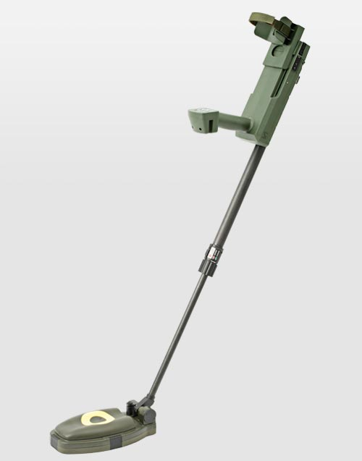
Search Equipment
Detectors (Passive)
  Dual Sensor mine detector for detection of metal and metal-free objects.
  IED threat environments with low-metal content explosive devices
  Generally combines traditional metal detector with GPR.
  Can either use both technologies simultaneously or each type independently.
  Usually very expensive and require significant training and practice.
Notes:
Dual-sensor mine detector for detection of metal and metal-free objects.
For AAST in IED threat environments with low-metal content explosive devices
Generally combines traditional metal detector with GPR.
Can either use both technologies simultaneously or each type independently.
Usually very expensive and require significant training and practice.
Image Top – An example of a commonly found dual use detector (Minehound VMR3). Note the head of the metal detector uses traditional metal detector capability, the yellow circle represents the smaller GPR capability.

Slide 47
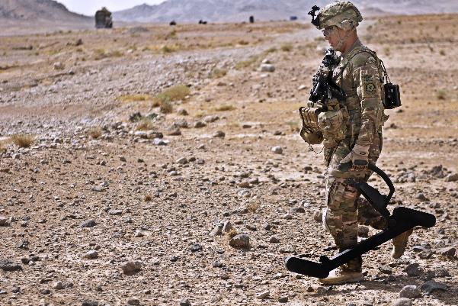


Search Equipment
Wire Detector or Hook
  Used to search for concealed command wires.
  Can be specialist electronic wire detector, specialist manual hook or improvised hook e.g. rake
Notes:
Image Top – Example of a special purpose wire detector (GOLDIE) image courtesy of US DoD.
Image Middle – Special purpose manual hook. Image courtesy of NIC Equipment
Image Bottom – Improvised hook such as a garden rake

Slide 48
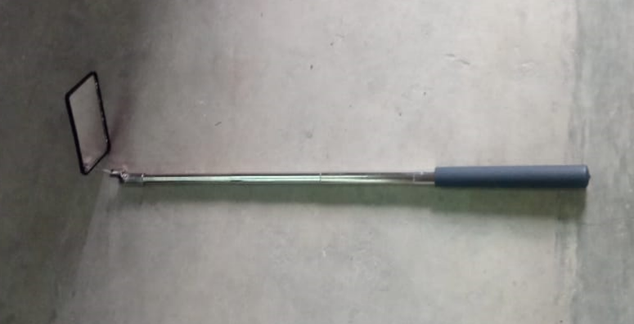
Search Equipment
Under Vehicle Mirror
  Used to search under vehicles

Slide 49
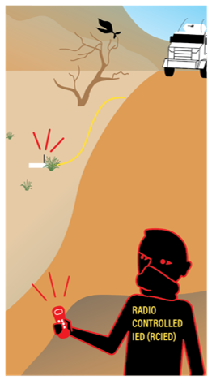
Search Equipment
Electronic Counter Measure (ECM) - Protective measure designed for use against threat of remote controlled improvised explosive devices (RCIED)
Notes:
Electronic Counter Measures (ECM) uses the electromagnetic spectrum to support Force Protection (FP) by mitigating the risk from RCIEDs. IED jamming systems provide a degree of protection against RCIEDs. Effective ECM can mitigate a perpetrator’s effective use of the electromagnetic spectrum (EMS) through using electromagnetic energy. However, it is only a supporting measure to mitigate the threat and does not guarantee protection against an IED threat in general, only to a limited extend against radio controlled IEDs (RC IEDs).

Slide 50
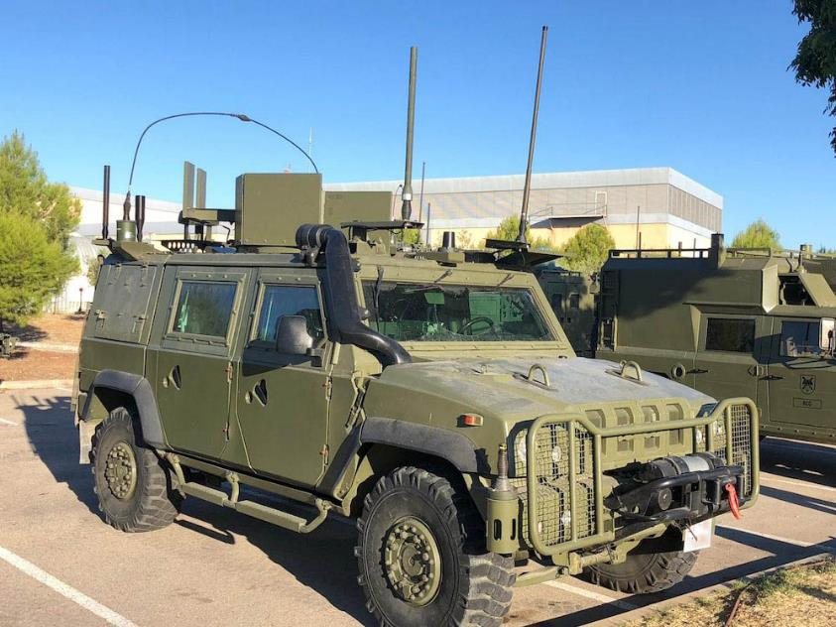
Search Equipment
Electronic Counter Measures (Jammers)
  Man-portable
  Vehicle Mounted
Notes:
Image Top – Team Commander carrying inert man-portable ECM . Image Courtesy Jordan Sorabjee
Image Bottom – Vehicle fitted with ECM. Image courtesy Netlinetech.com

Slide 51
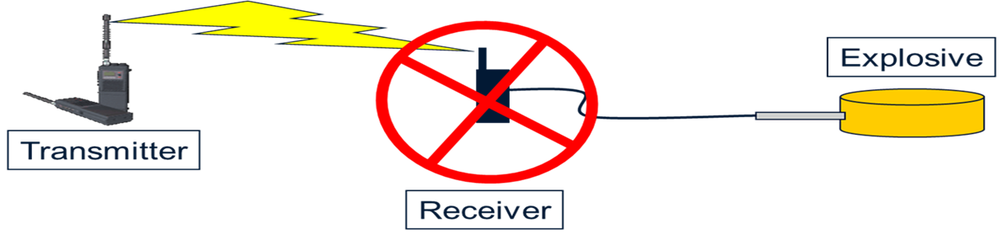
Search Equipment
Notes:
The purpose of electronic warfare is to deny the opponent the advantage of, and ensure friendly unimpeded access to, the electromagnetic spectrum.
ECM Units generate jamming from Antennas and block any signal in designated frequencies.
According to the waveform’s programme the jamming creates an area of protection which prevents triggering of RCIED.

Slide 52






Search Equipment
ECM transmits an overwhelming signal such that the receiver cannot determine the transmitters signal
Power jamming
Notes:
ECM works in two ways.
1. Power jamming. ECM emits a very strong signal which essentially overpowers the triggerman signal, preventing from initiating the device.

Slide 53
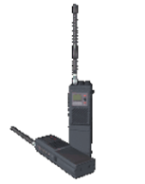






Search Equipment
ECM transmits random data to prevent the receiver from seeing the transmitter signal
ECM does not affect the threat transmitter
Sequence manipulation
Notes:
ECM works in two ways.
2. Sequence manipulation. The ECM Unit transmits random data that confuses the receiver and prevents the command signal from being understood.

Slide 54
Search Equipment
https://www.youtube.com/watch?app=desktop&v=I_nMjILBXYU
Notes:
NOT TO BE INCLUDED IN ITS SUBMISSION
Marketing video shows how ECM works.

Slide 55
Search Equipment
VP
RCIED
ECM vehicle
ECM vehicle
Notes:
There will rarely be enough ECM or all vehicles and personnel. ECM must be employed in the most efficient manner possible. Considerations
Convoy spacing should overlap effective ECM range
Front and rear vehicle covered
Spacing should vary according to terrain
Check with your ECM manager to confirm systems do not interfere with each other
Conduct 5/25m checks at halts and before turning ECM off
Ensure preventative maintenance and testing has been carried out

Slide 56
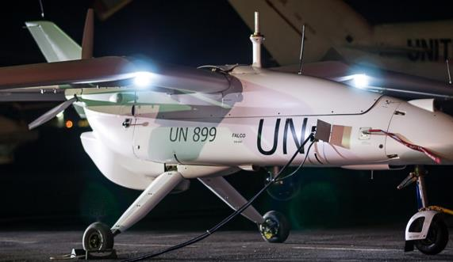
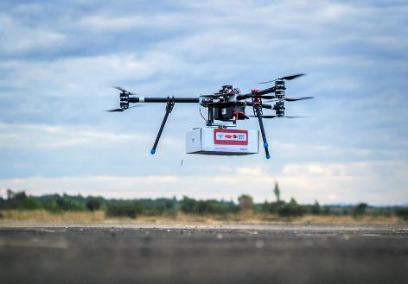
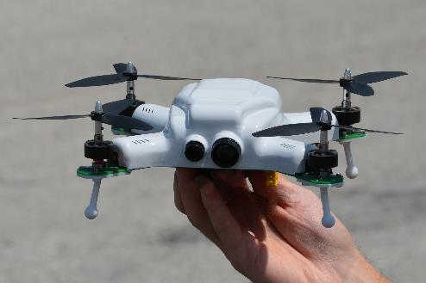
Search Equipment
Air and Aviation Support – UAS
UAS assets vary considerably in size. This affects range, endurance and sensors.
May be used as a tool to support search operations
Require planning in advance
Notes:
UAS assets vary considerably in size, from Class I systems that can be carried by one person and operated from almost any location, up to Class II and Class III systems that can be a similar size (and have similar support requirements) as a crewed aircraft.
UAS may be used as a tool to support search operation. This could include identification of and preliminary search of VPs and VAs. Searching for firing points and triggermen or looking for secondary threat.
It is important to note that UAS need to be planned in advance and requires integrated training and communication to be affected. Small UAS also may be affected by ECM preventing their use.
Image Left – UN Fixed wing UAS in DRC. UN Photo
Image Centre – UNICEF UAS. UN Photo
Image Right – Micro UAS that can be deployed very quickly and carried by almost any troops. Image courtesy of Spectral Aviation.

Slide 57
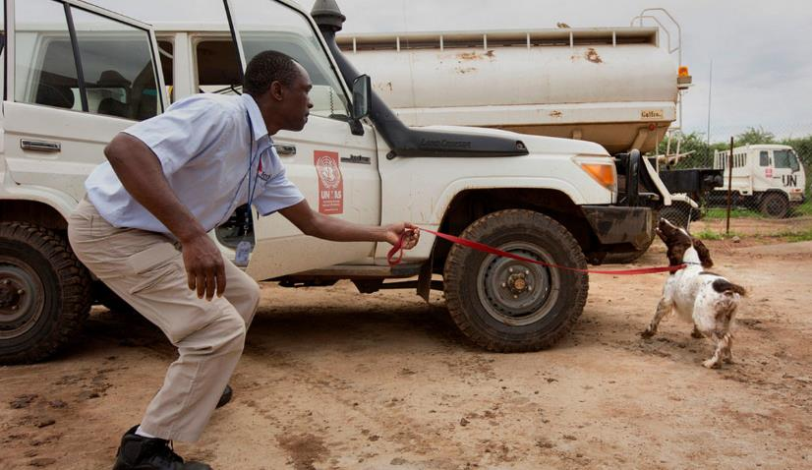
Search Equipment
Search – Explosive Detection Dogs
Explosive Detection Dogs (EDD) trained to locate and correctly indicate explosive substances
Target active threats
Considerations:
  Handler + Dog
  Special support required
  Early planning
Notes:
Explosive Detection Dog (EDD), refers to a dog specifically trained to locate and correctly indicate, the presence of vaporised molecules of defined explosive substances. EDDs are used in many different roles within security risk mitigating operations and, as such, complement an existing security framework. EDDs are well suited for activities such as, Entry Control Point (ECP) deployment (vehicle and luggage/cargo verification), facility security verification, open area verification and IED incident response.
EDD training and deployment are significantly different from those of Mine Detection Dogs (MDDs). EDDs target an “active threat,” which is the main reason why the prevention of “false indications” during assessment procedures is more important for EDDs than for MDDs. Additionally, EDDs operate in search areas where control of surroundings (environmental control) cannot always be achieved, which increases the demands on their ability to operate in different environments with disturbances, as well as on environmental stability.
Planning Considerations:
EDD is the dog and the handler
EDD require climate controlled living spaces, break areas and vehicles. EDDs may also require a specific diet that is not available in the host country. Additional equipment, and support requirements may vary dependent on troop contributing nation. If deploying an EDD the vehicle space for dog and handler, as well as air conditioning, food and water must all be factored.
EDD Logistics support, limitations and capabilities should be addressed early in the mission planning process, if EDDs will be used.

Slide 58
Search Equipment
Search – Explosive Detection Dogs
Limitations:
  Time
  Wind
  Rain
  Heat
Notes:
Just like humans, EDD cannot work indefinitely. They need to be used for a limited specific time periods before being rested. This time will depend on the environmental conditions such as the temperature. It is also worth noting that EDD rely on their sense of smell. Factors such as strong wind and rain will severely affect the dogs ability to identify a target.

Slide 59
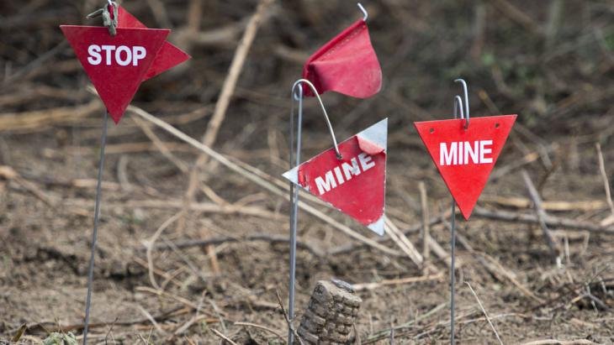

Questions?

Slide 60
Move to Search Equipment Demonstration

